Slide 1
Python PROGRAMMING
LESSON
Presented by: KUSHAGRA GUPTA 🔗
Notes:
Lets talk about the word programming itself. Lets see the evolution of English language and the further progression in Computer world

Slide 2
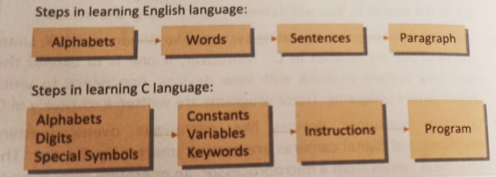
WHAT IS PROGRAMMING?

Slide 3




















WHAT IS PROGRAMMING?

Slide 4
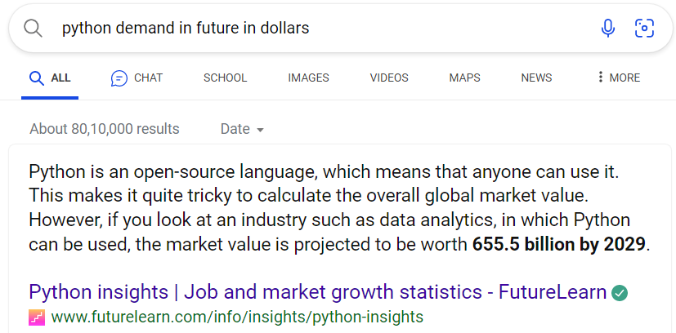
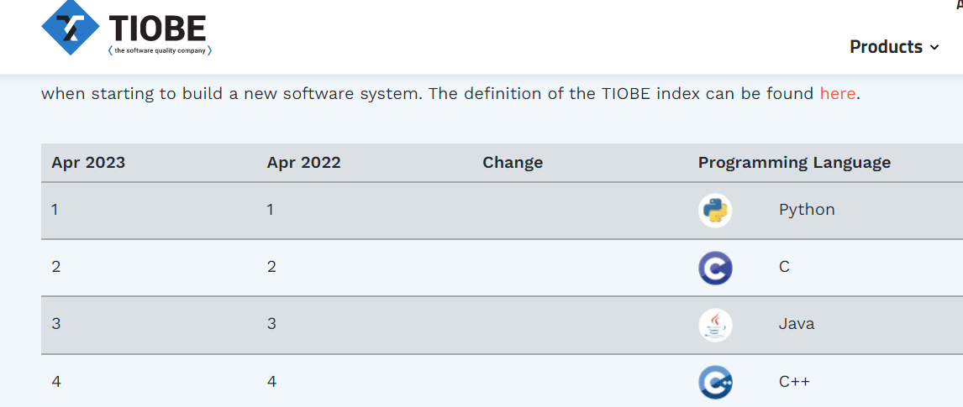
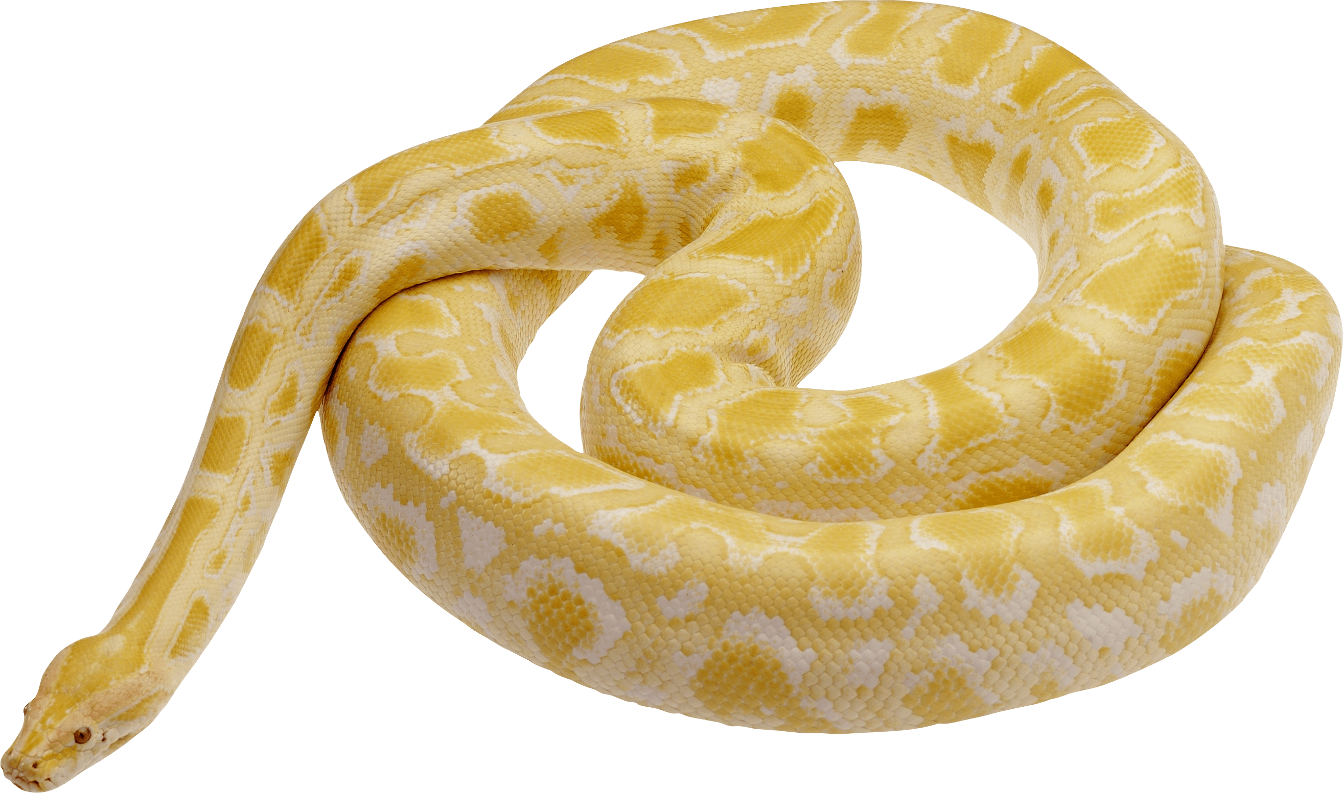










WHY SHOULD I LEARN PYTHON IN 2023?

Slide 5














EXCLUSIVE FEATURES OF PYTHON

Slide 6


FROM GUTENBERG TO YOUR PC…
Print Statement Implementation :

Slide 7
FROM GUTENBERG TO YOUR PC…
Print Statement (return concept):

Slide 8
FROM GUTENBERG TO YOUR PC…
Print Statement using seprator and end:

Slide 9
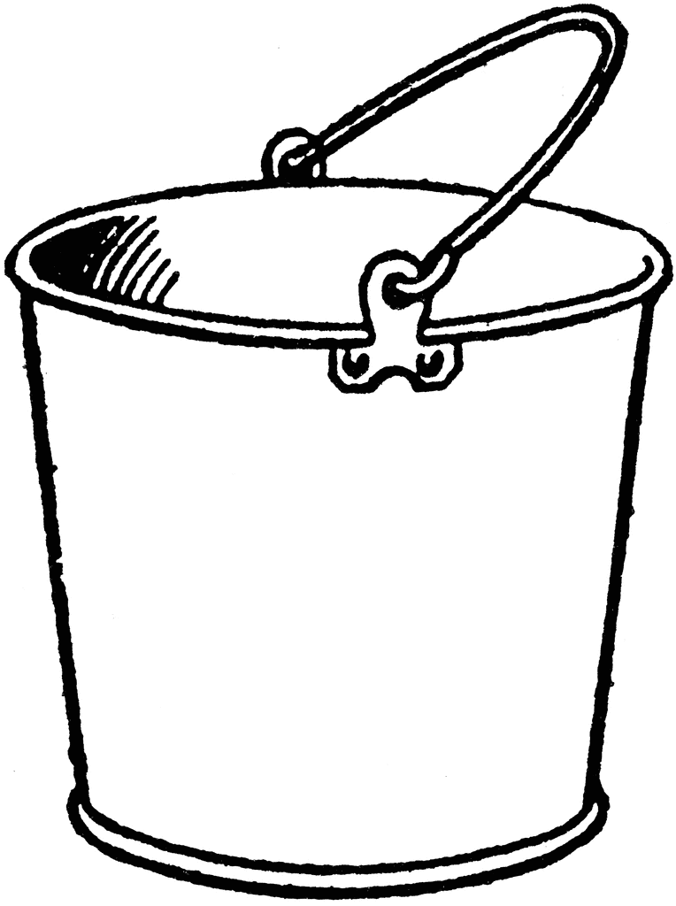














VARIABLES

Slide 10
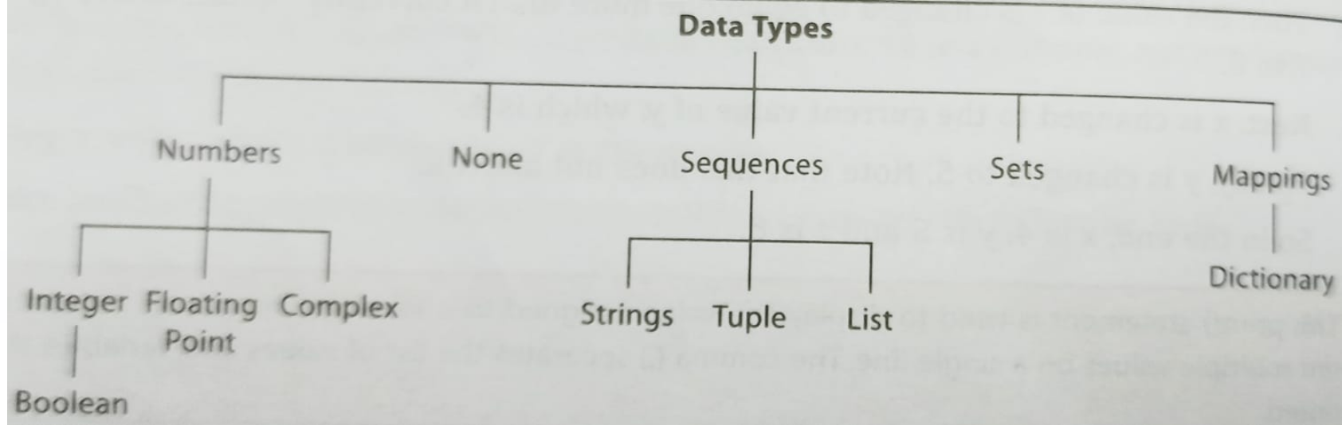
TYPES OF VARIABLES/DATA TYPES

Slide 11








SYNTAX OF DECLARING VARIABLES

Slide 12
RULES ON DECLARING VARIABLES
Variable names must start with a letter or underscore (_), followed by any combination of letters, numbers, or underscores.
Variable names are case-sensitive, so "myVar" and "myvar" are considered different variables.
Avoid using reserved words as variable names, such as "if", "else", "while", etc.
Use descriptive and meaningful variable names that indicate the purpose of the variable.
You do not need to declare the data type of a variable explicitly. Python uses dynamic typing, which means that the data type is determined automatically based on the value assigned to the variable.
Variables can be assigned values using the assignment operator "=", such as x = 42.
You can assign multiple variables at the same time using tuple unpacking, such as x, y, z = 1, 2, 3.
You can reassign a variable to a new value at any time, even with a different data type, such as x = "hello".

Slide 13
HANDS ON DATA TYPES

Slide 14
HANDS ON DATA TYPES

Slide 15

HOW TO TAKE INPUT?

Slide 16
HOW TO TAKE INPUT?

Slide 17
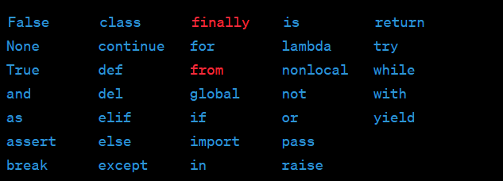
RESERVED KEYWORDS

Slide 18















EXPRESSIONS IN PYTHON

Slide 19

EXPRESSIONS IN PYTHON

Slide 20
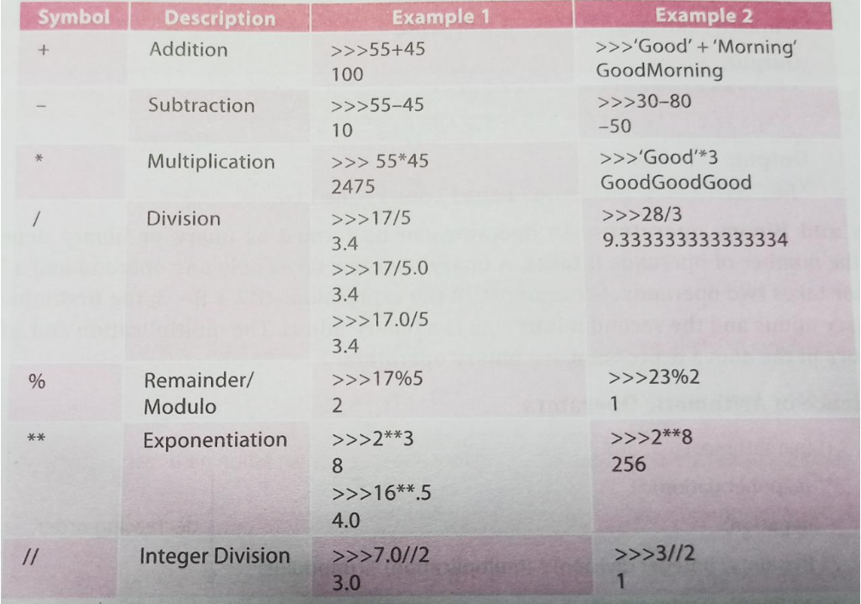
OPERATORS IN PYTHON

Slide 21
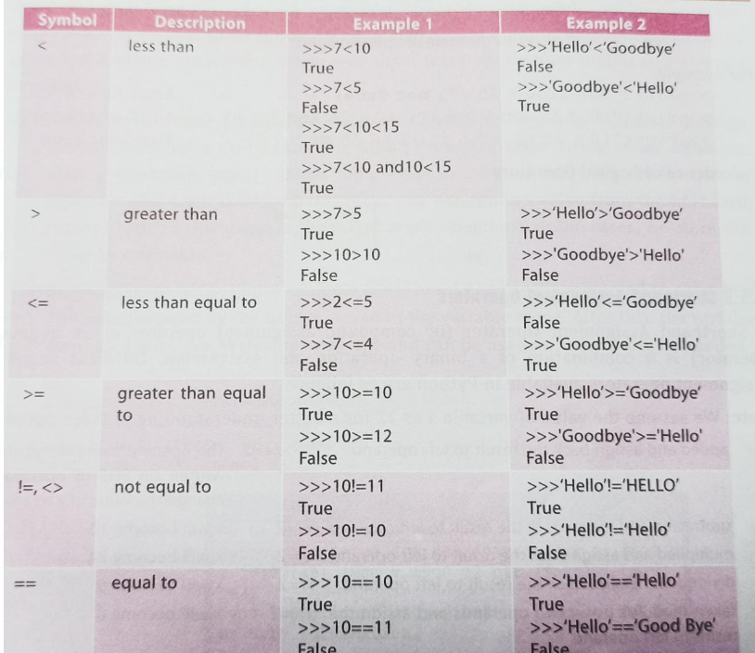
RELATIONAL OPERATORS IN PYTHON

Slide 22
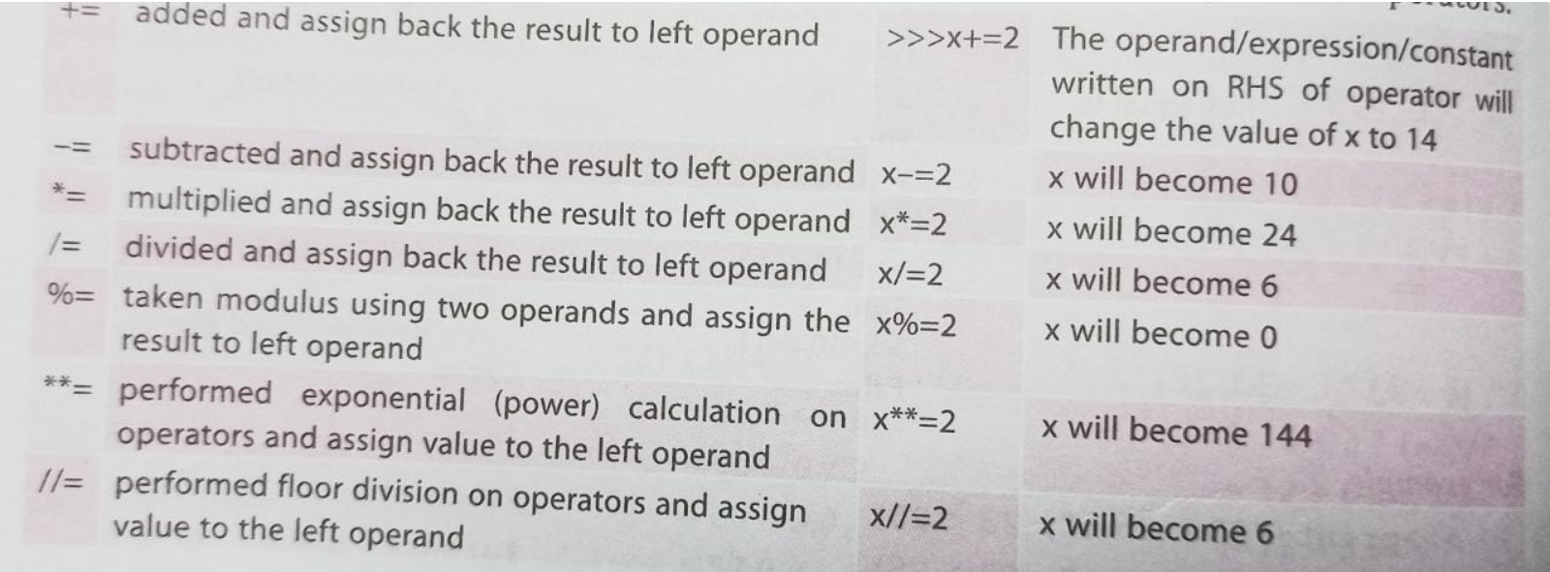
SHORTHAND ASSIGNMENT OPERATORS IN PYTHON

Slide 23

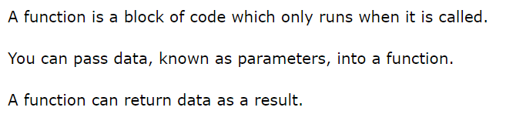
FUNCTIONS

Slide 24















WHY FUNCTIONS?

Slide 25
















CONDITIONAL STATEMENTS

Slide 26












DECISION TREE

Slide 27
DECISION TREE
Fizz Buzz - LeetCode

Slide 28
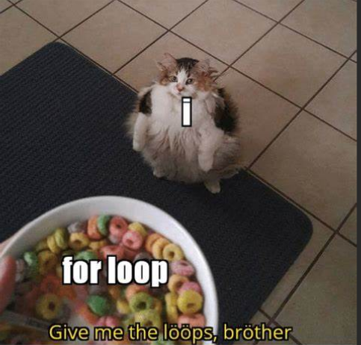
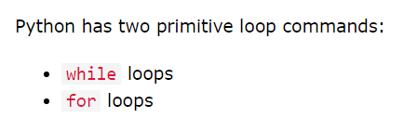
LOOPS

Slide 29














WHY LOOPS?

Slide 30













LOOPS

Slide 31











HOW TO SELECT WHICH LOOP TO USE

Slide 32
LOOPS

Slide 33
LOOPS

Slide 34
LOOPS
Concatenation of Array - LeetCode

Slide 35









LAMBDA

Slide 36
LAMBDA FUNCTION

Slide 37
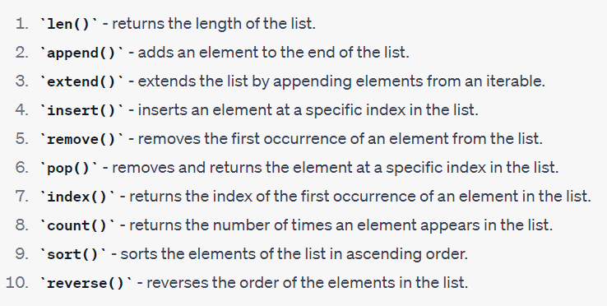
LIST AND ITS OPERATION

Slide 38
LIST AND ITS OPERATION

Slide 39
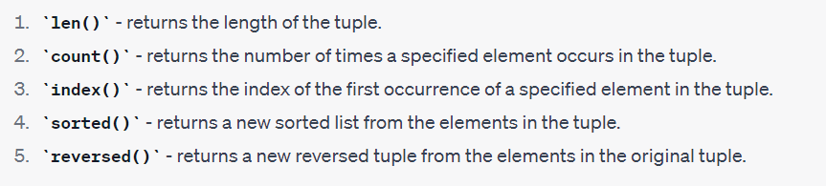
TUPLE AND ITS OPERATION

Slide 40
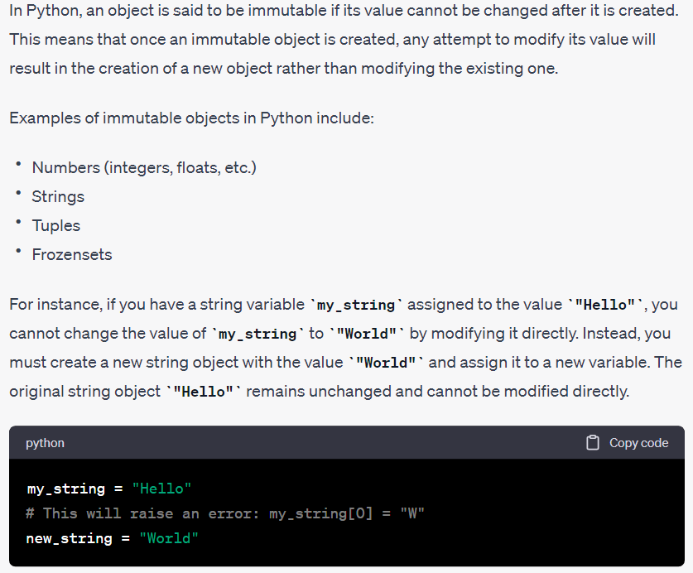














TUPLE AND ITS OPERATION

Slide 41
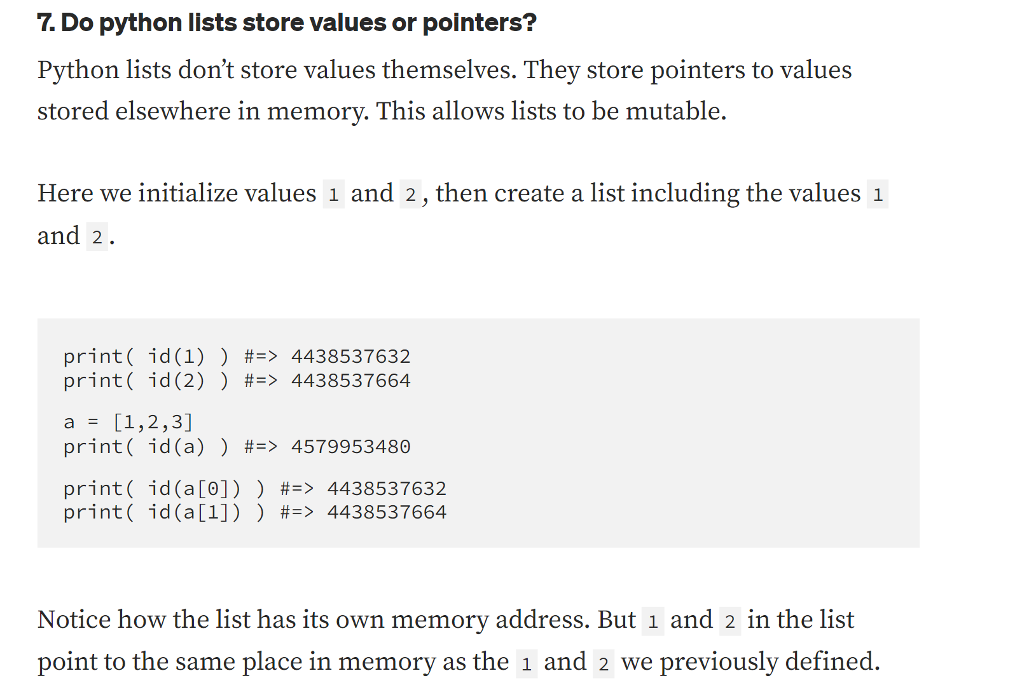



SPECIAL NEED OF TUPLE

Slide 42

















SPECIAL NEED OF TUPLE

Slide 43
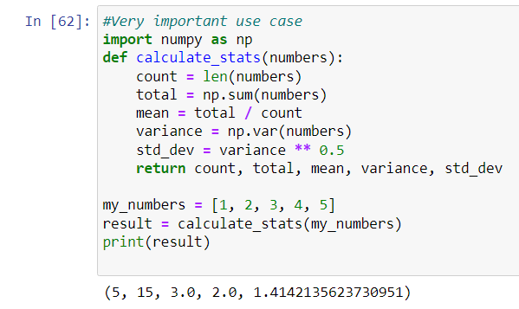
SPECIAL NEED OF TUPLE

Slide 44









DICTIONARIES IN PYTHON

Slide 45






































WHY DICTIONARIES

Slide 46
DICTIONARIES IMPLEMENTATION

Slide 47
DICTIONARIES IMPLEMENTATION

Slide 48
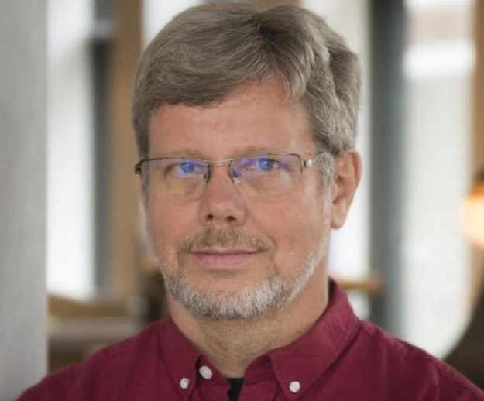

ABOUT THE INVENTOR HIMSELF
Guido Van Rossum created Python whose implementation is done in C Language.
Guido van Rossum (@gvanrossum) / Twitter
Why not follow the real Chads!

Slide 49
ABOUT PROJECT
We will be reviewing to make a BlackJack Card game.
I have attached The code for this same project. I would advice you to code by yourself based on practicing todays session and try to map out which all data structures will be used. Try to figure out

Slide 50
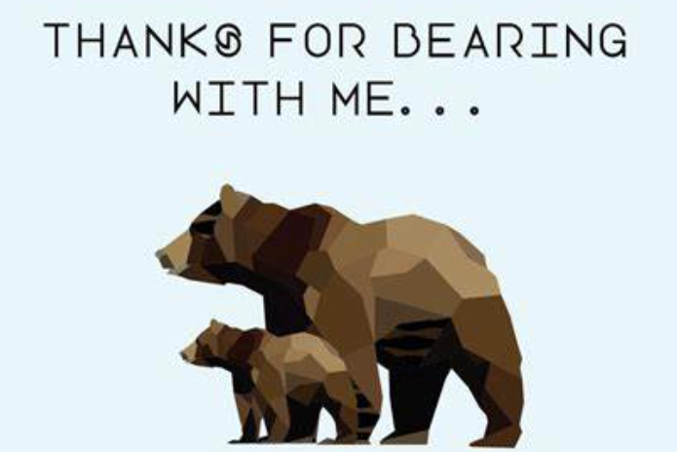
THANKS!
Do you have any questions?
youremail@freepik.com
+91 620 421 838
yourcompany.com

Slide 51
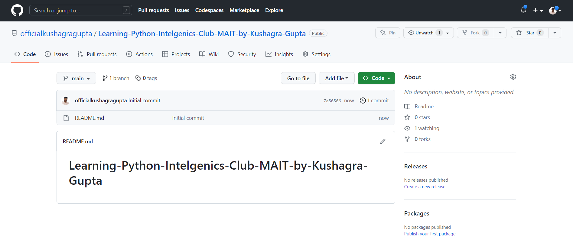
THANKS!
Do you have any questions?
youremail@freepik.com
+91 620 421 838
yourcompany.com

Slide 52



Github profile:
https://github.com/officialkushagragupta
TWITTER PROFILE:
Kushagra Gupta (@effervescent_kg)

Slide 53
Thanks for your patient hearing.
Any doubts regarding the course of this session are welcome!

